Slide 1
Big Mountain Resort
Report on Increasing Ticket Prices Based on Available Features

Slide 2
Problem
Goal
The recently installed chair lift at the resort has increased operating costs by over $1.5m.
The ticket price is suspected to not accurately reflect the features available at the resort
Find ticket price adjustment to account for new costs generated by the chair lift, while also remaining competitive with other resorts by focusing on the relationship between resort features and ticket price.

Slide 3
Findings
Fast quads, total chairs, runs, snow making area, and vertical drop were all important factors in determining the ticket price. (Shown in lower right image)
Big Mountain ranked very highly in all of these categories, and is able to raise the ticket price accordingly
Big Mountain can certainly raise ticket price while remaining competitive

Slide 4
Recommendation
Proceed with the decision to increase the vertical drop by 150 ft by adding a run, installing a new chair lift to accommodate.
Do not add snow making area for the new run, as this will increase cost but have no effect on ticket price.
Shut down the least used run to further decrease operating costs.
Increase ticket price by $6.00, to $87.00

Slide 5
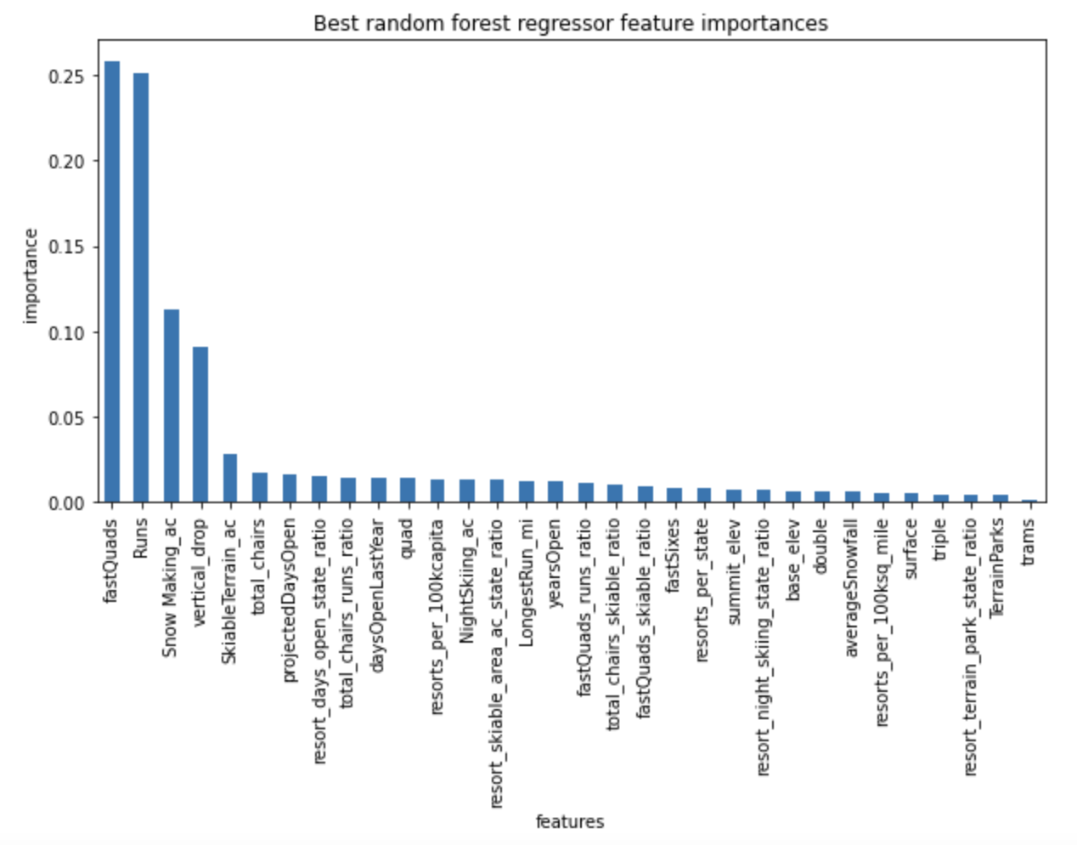
Model
Random forest model
Performed better than a linear model
Important features are shown in the histogram to the right

Slide 6
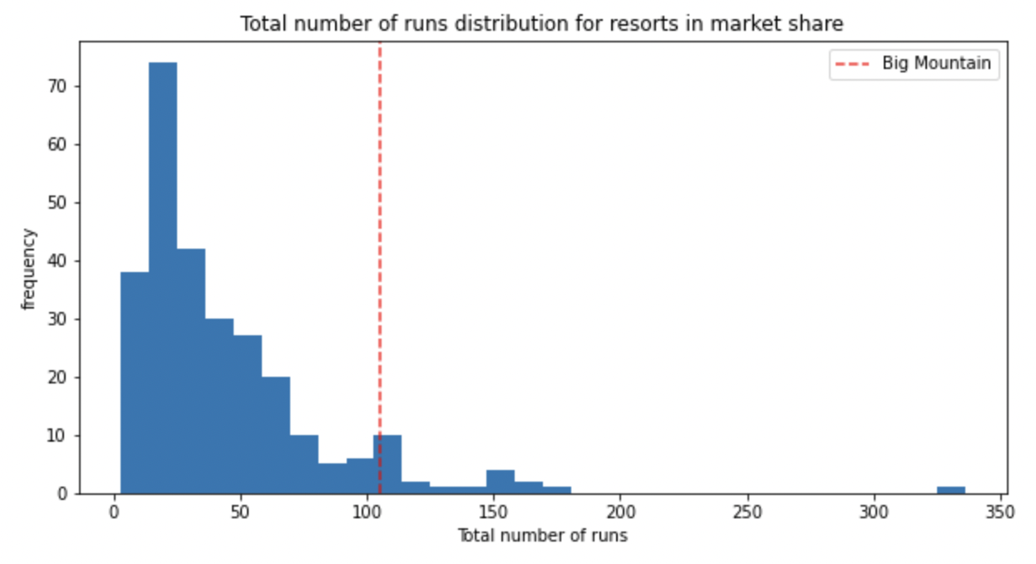
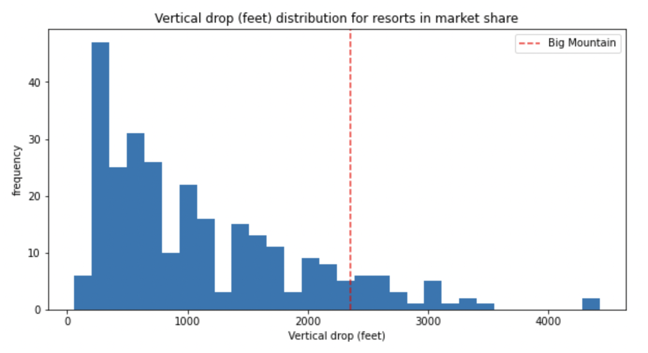
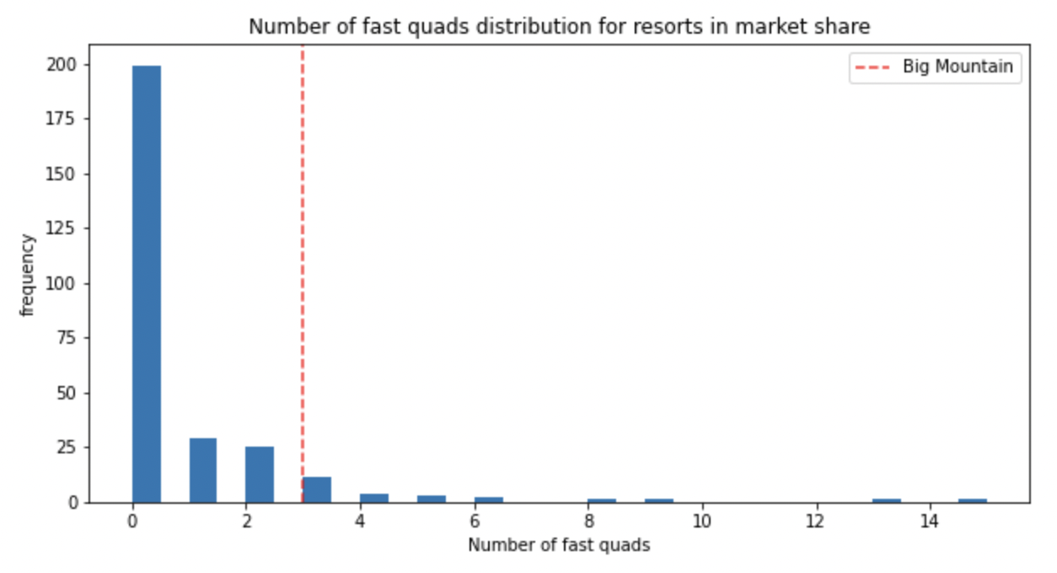
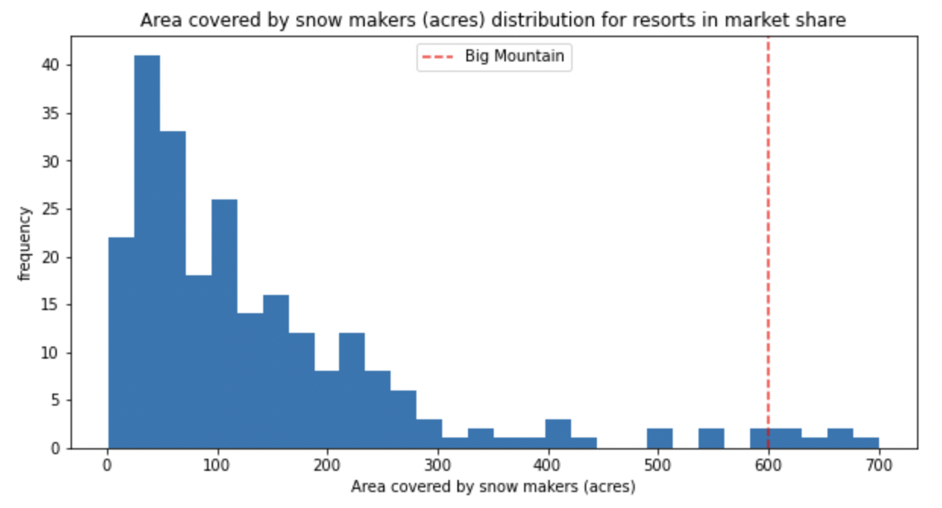
Big Mountain’s Standing
Big Mountain’s position on the distribution is shown by the red line.
As you can see, Big Mountain is near the top for all important features.
Most resorts have no fast quads, while Big Mountain has 3
Our model found fast quads to be the most important feature

Slide 7
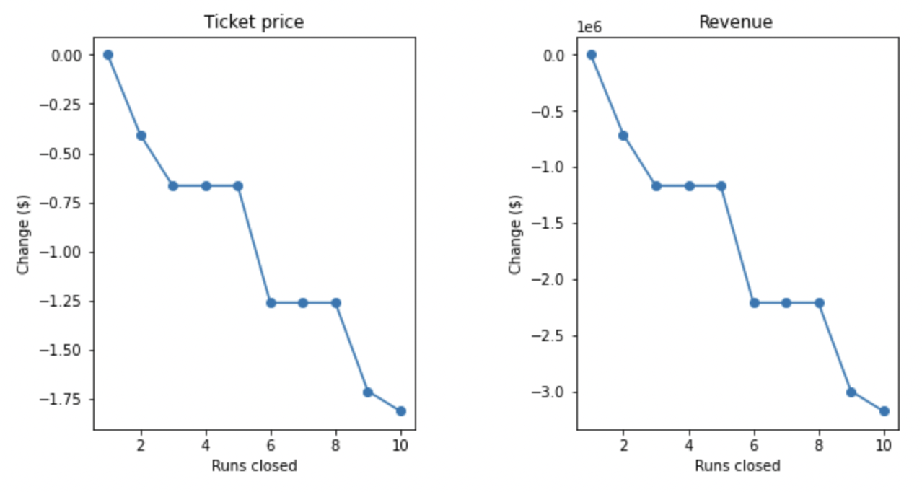
Closing Runs
Closing a single run had no effect on ticket price/revenue.
Closing more runs resulted in a steep decline in ticket price/revenue.
The cost of operating the run should be considered against the drop in revenue when deciding whether to close a run, or not.

Slide 8
Summary
The model suggests that we could raise the ticket price by $4.48, to $85.48, based off of the current features at the park.
Adding a run to increase the vertical drop and adding a new chair lift to service the new run, would further increase this price by $1.99
Snow making area for the new run will not justify increasing the ticket price further, but will increase cost, so it should be avoided.
Closing the least used run will not decrease revenue, but will decrease cost.
The additional revenue generated by this ticket price change will be $10.5m.

